Slide 1
Magnetic Fields (Chapter 28)

Slide 2
What is Magnetic Field
A magnetic field is a field of force produced by magnetic materials, moving electric charges, or changing electric fields.
It is space around a permanent magnet or moving charge particle where another magnetic material experiences a magnetic force. Its unit is Tesla. It is also measured in Gauss and is represented by the vector B. It is vector quantity
The direction of the Magnetic Field is characterized by the lines of magnetic field lines around any magnet (Permanent or electromagnet).
The direction of the tangent to a magnetic field line at any point gives the direction of B at that point

Slide 3
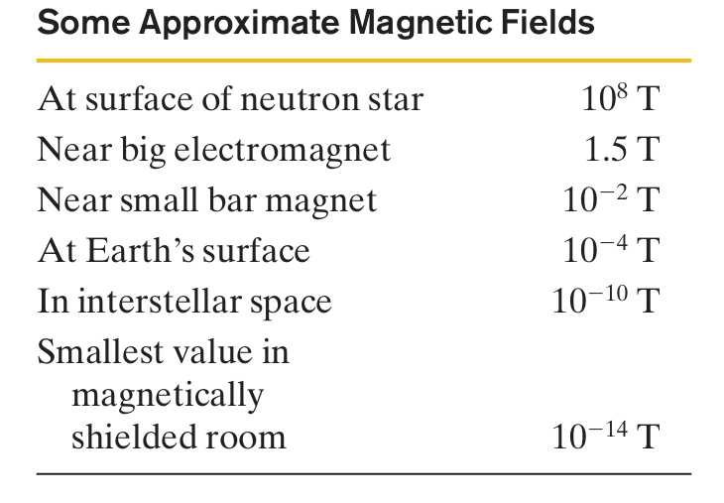
Magnetic Filed

Slide 4
Sources of magnetic field
An electric field E: is produced by an electric charge, we might reasonably expect that a magnetic field B: is produced by a magnetic charge. Although individual magnetic charges (called magnetic monopoles) are predicted by certain theories, their existence has not been confirmed. How then are magnetic fields produced? There are two ways.
1) One way is to use moving electrically charged particles, such as a current in a wire, to make an electromagnet.
2) The other way to produce a magnetic field is by means of elementary particles such as electrons because these particles have an intrinsic magnetic field around them. Magnetic fields of the electrons in certain materials add together to give a net magnetic field around the material. Such addition is the reason why a permanent magnet is formed and can be used as a source of magnetic field.

Slide 5
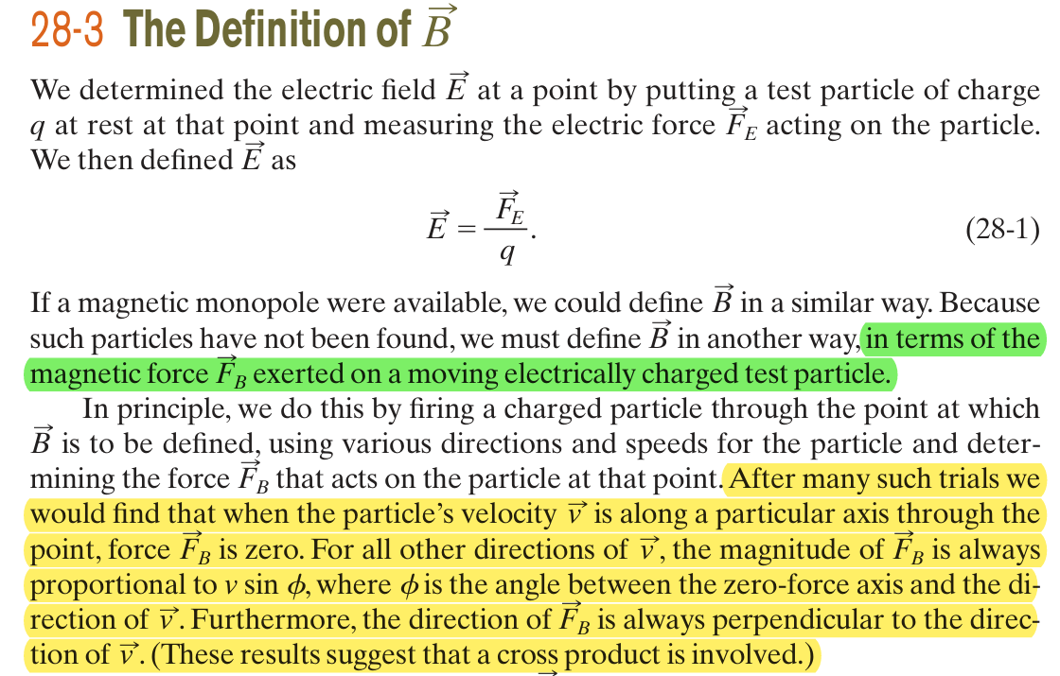
Definition of Magnetic Field

Slide 6
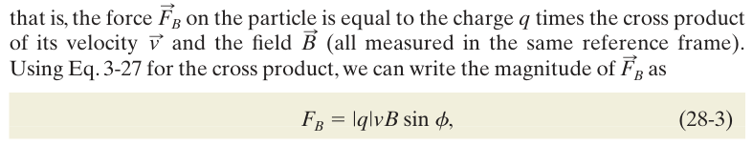
Force on a charged particle
The force exerted by the magnetic field on that moving particle due to magnetic field B is

Slide 7
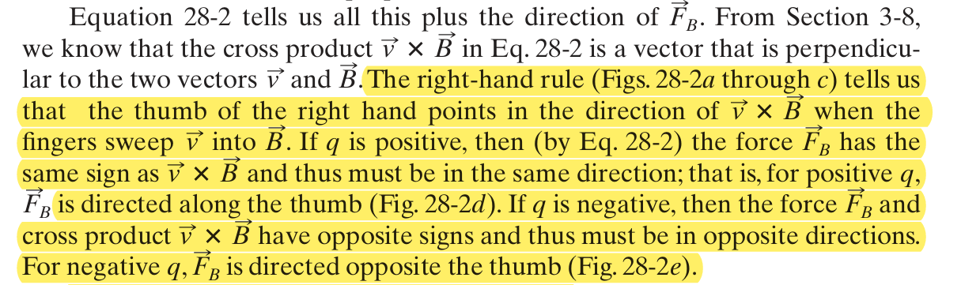
Force on a charged particle

Slide 8
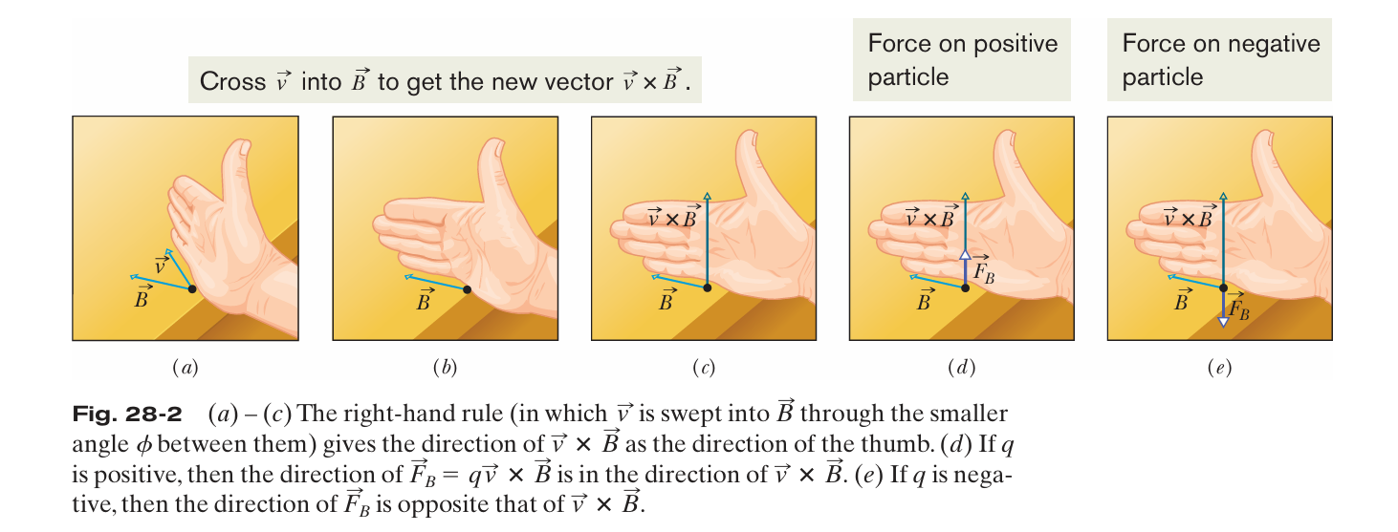
Force on a charged particle

Slide 9
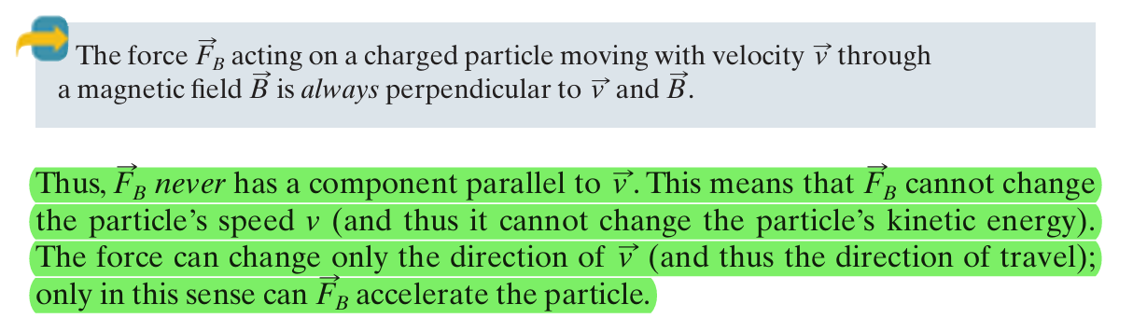
Force on a charged particle

Slide 10
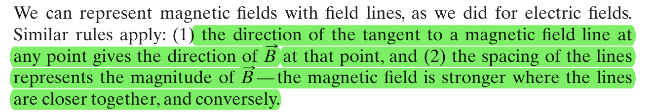
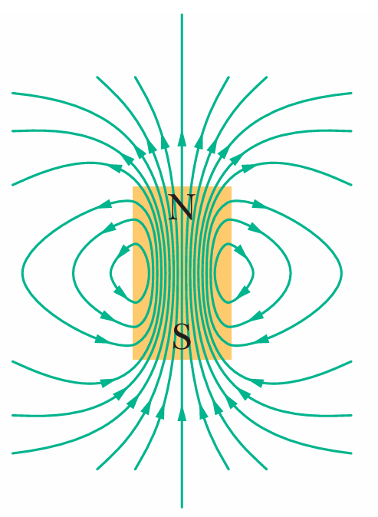
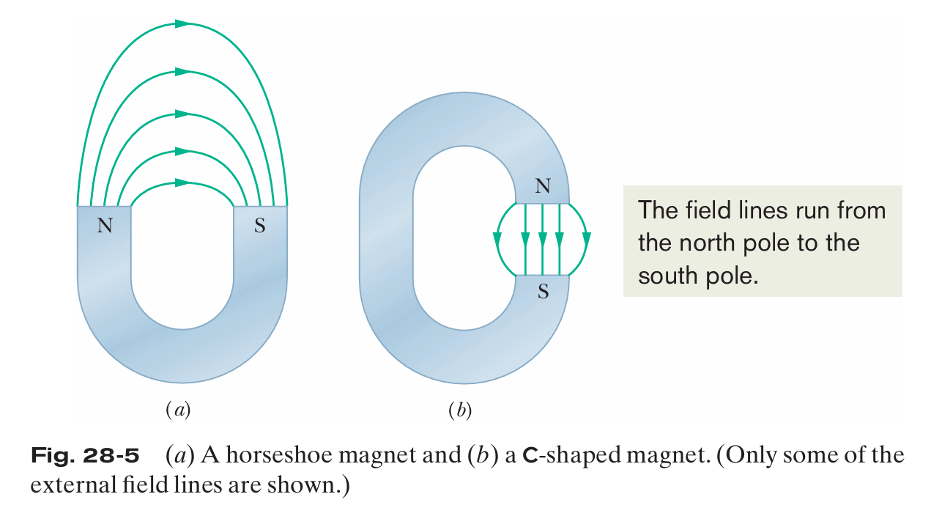
Magnetic Field Lines

Slide 11
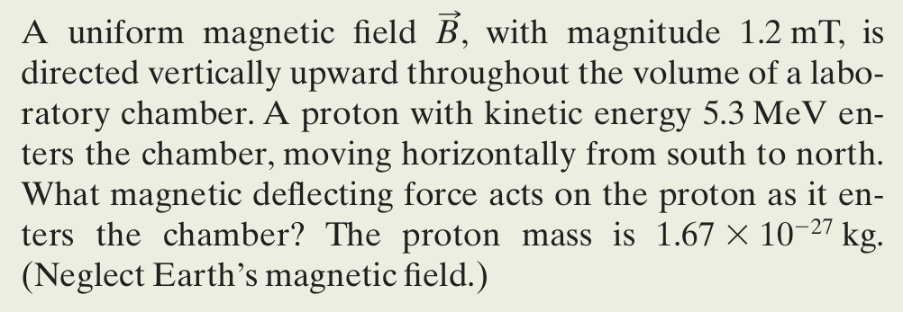
Magnetic force on a moving charged particle (Problem)

Slide 12
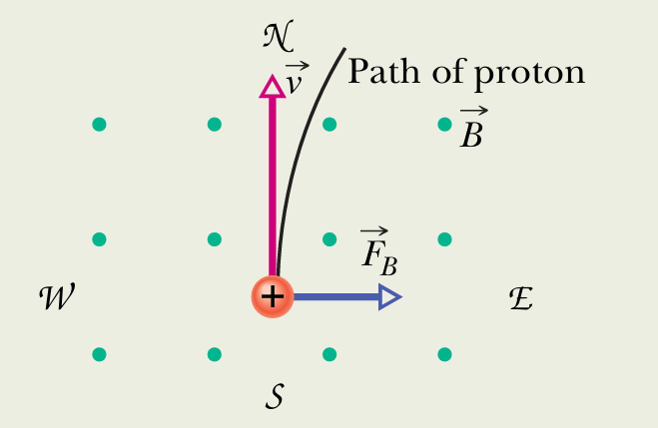
Continued…

Slide 13
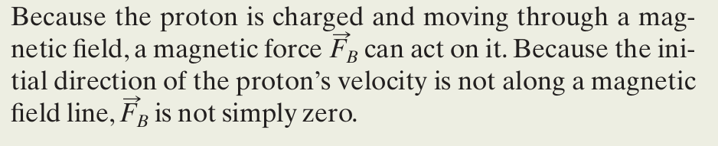
Continued…

Slide 14
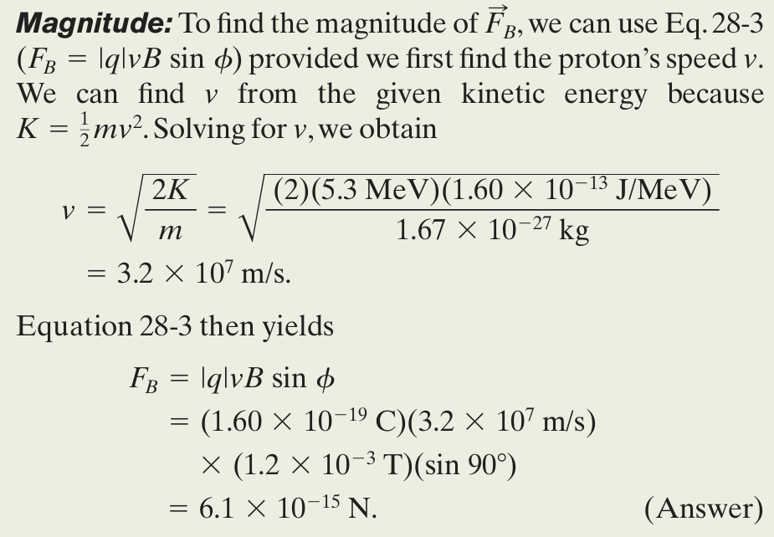
Continued…

Slide 15
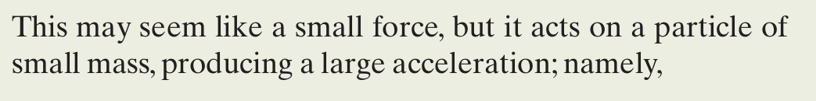
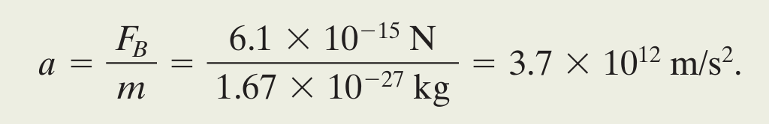
Continued…

Slide 16
Magnetic Force on a Current-Carrying wire (Chapter 28)

Slide 17
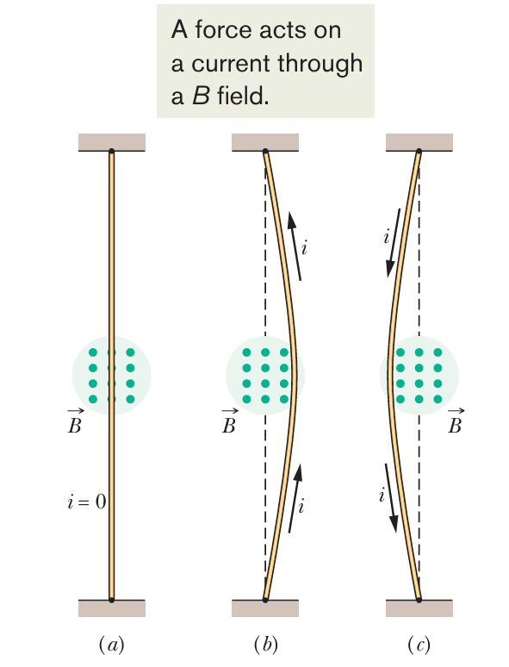
In Fig. 28-14a, a vertical wire, carrying no current and fixed in place at both ends, extends through the gap between the vertical pole faces of a magnet. The magnetic field between the faces is directed outward from the page. In Fig. 28-14b, a current is sent upward through the wire; the wire deflects to the right. In Fig. 28-14c, we reverse the direction of the current and the wire deflects to the left.

Slide 18
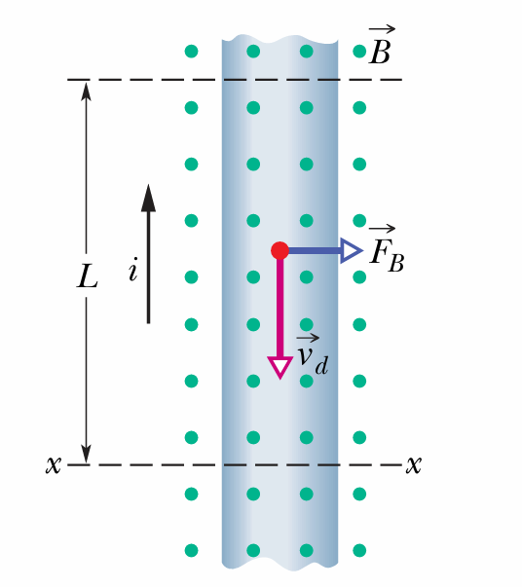
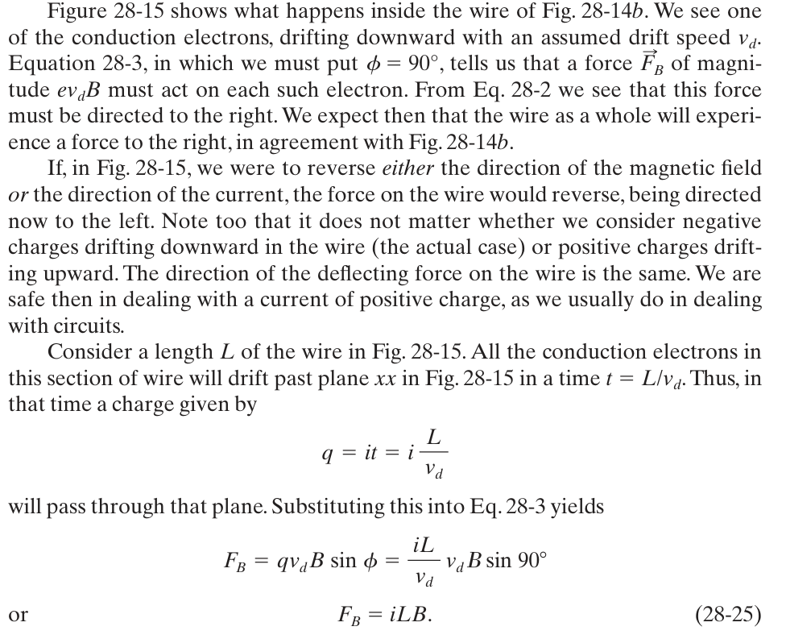

Slide 19
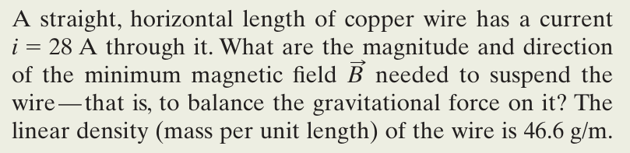
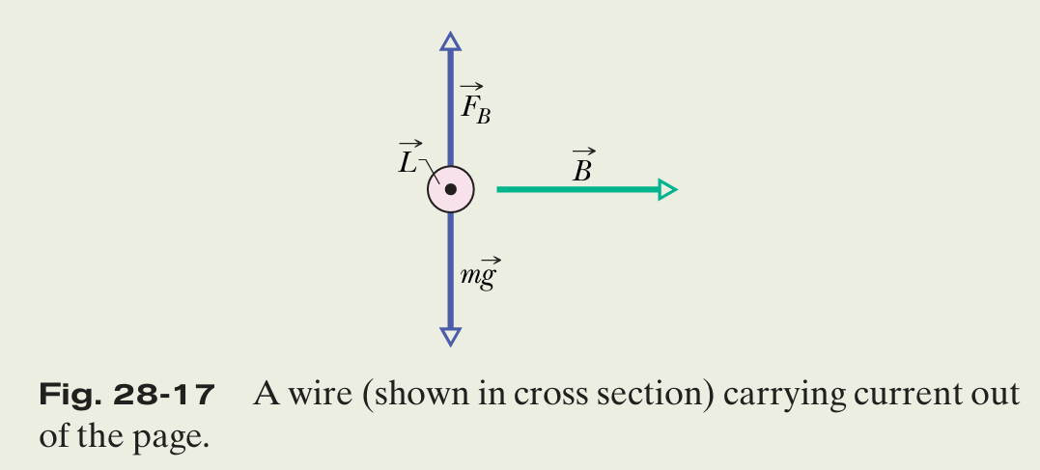
Magnetic force on a wire carrying current (Problem)

Slide 20
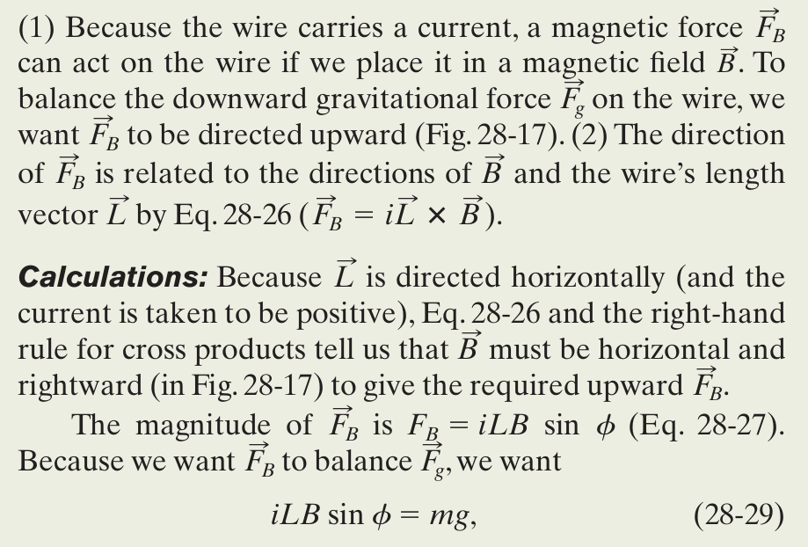

Slide 21
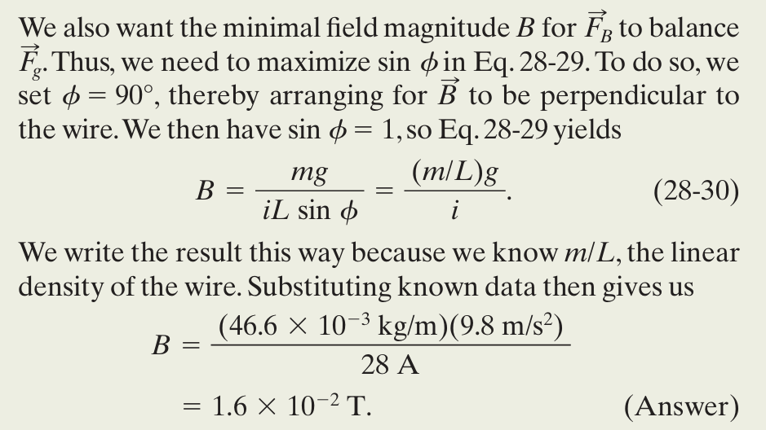

Slide 22
Torque on a Current Loop (Chapter 28)

Slide 23
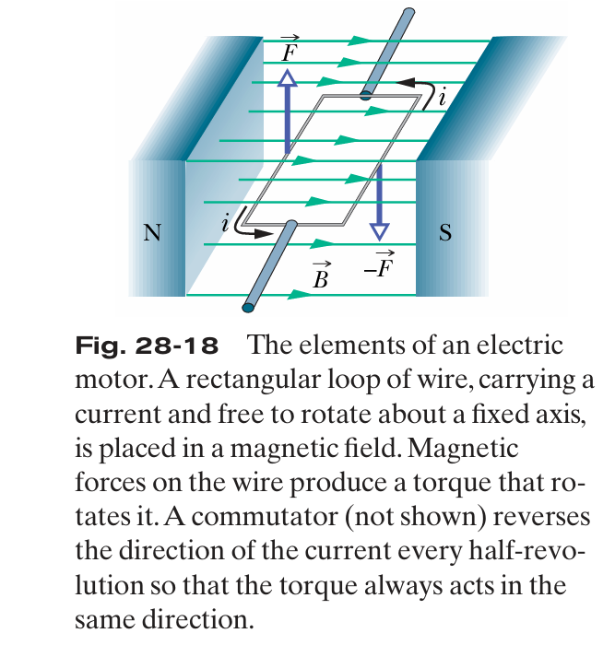
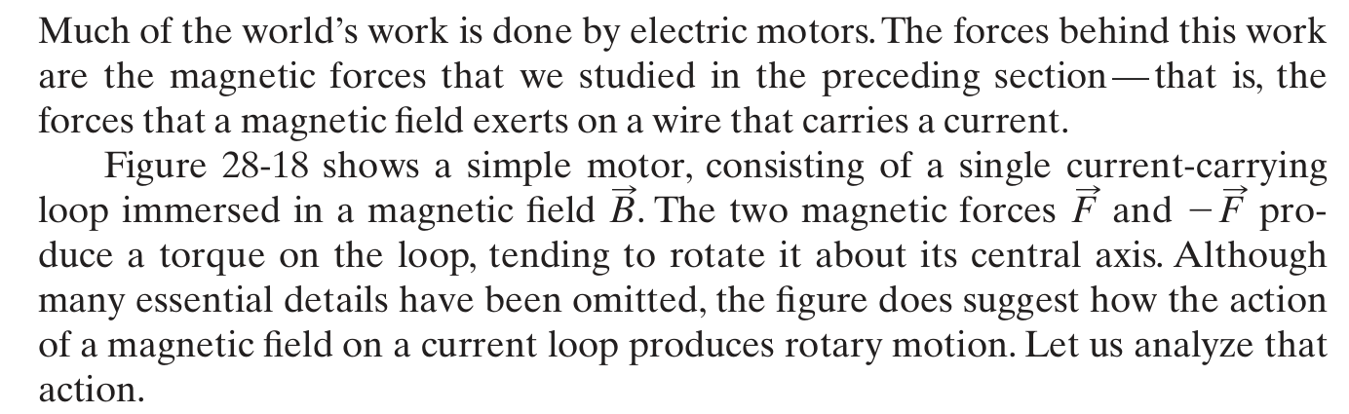

Slide 24
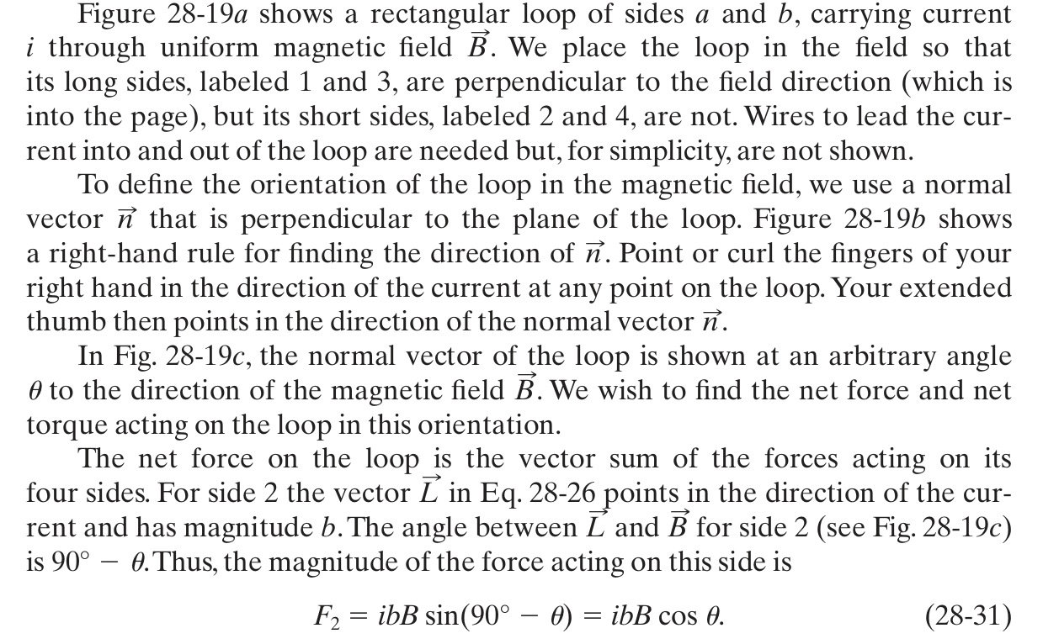

Slide 25
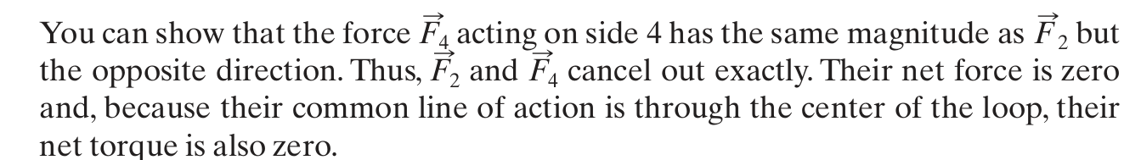
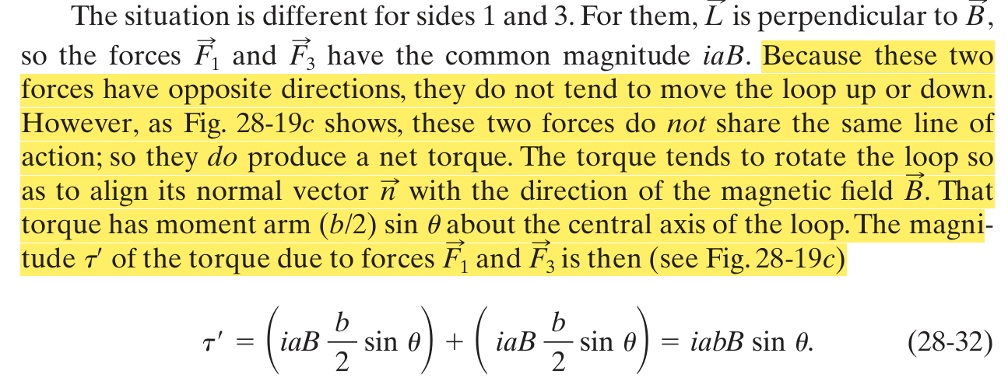

Slide 26
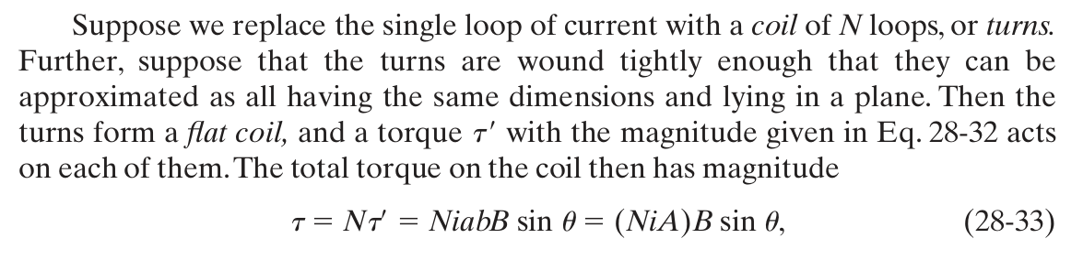

Slide 27
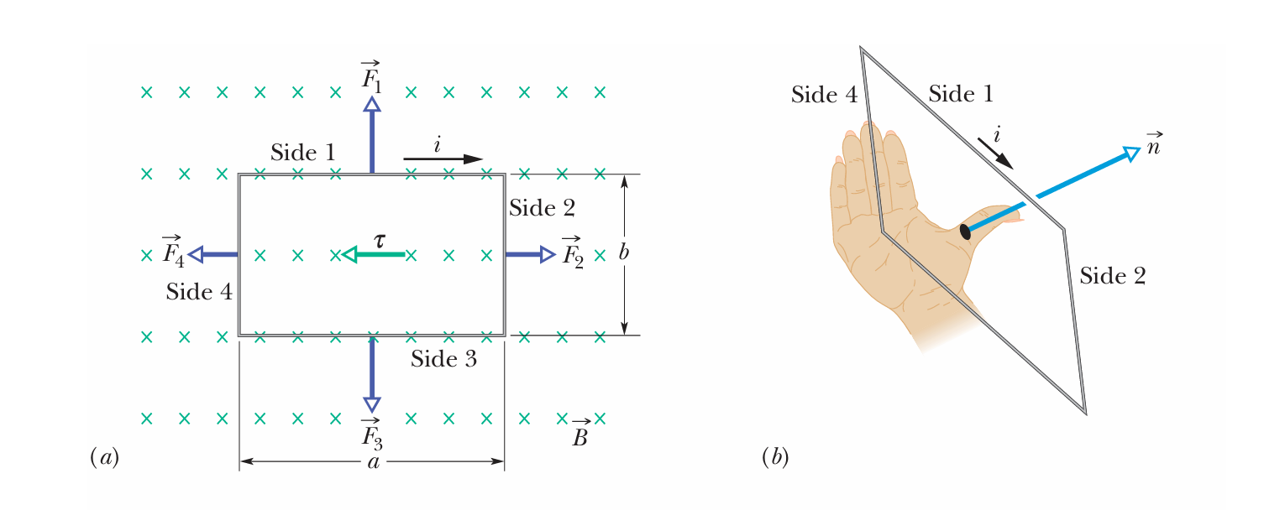
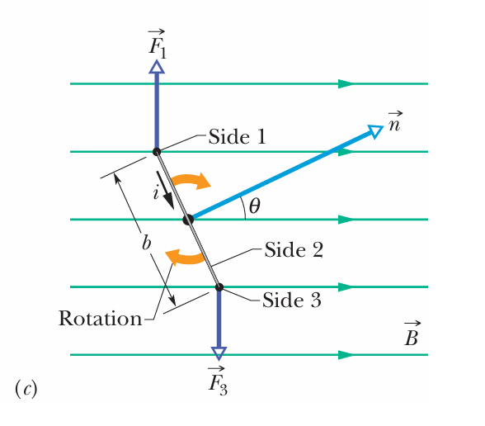

Slide 28
Faraday’s Law of Electromagnetic Induction Chapter 30

Slide 29
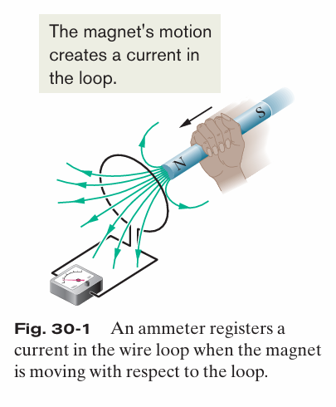
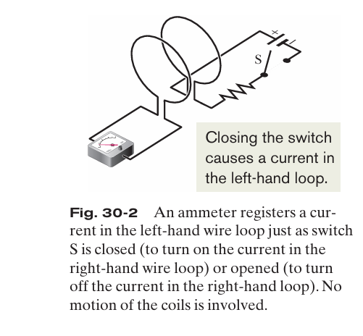
The Two methods of electromagnetic induction

Slide 30
Faraday’s Law of Electromagnetic Induction
The Two experiments shows that how can and induced EMF due to electromagnetic induction can result in the induction of EMF.
Michael Faraday gave two important law’s on the basis of these experiments named them as Faraday’s first and second law of electromagnetic induction.
First law gives a qualitative relationship in between changing magnetic field and induced EMF and second law gives a quantitative explanation of relationship between magnetic field and induced EMF in the similar way as Newton’s first and second law gives for the force.

Slide 31

Faraday’s Law of Electromagnetic Induction
Due to the changing magnetic field, the electromagnetic force (EMF) is induced in a circuit, and therefore, a current is produced. This is called electromagnetic induction.
First law: It states that whenever there is a change in magnetic flux associated with a coil, EMF is induced in that coil.
Second law: It states that the magnitude of EMF induced in the coil is directly proportional to the rate of change of magnetic flux associated with that coil.
Mathematically, it can be expressed as 𝜀=-𝑑𝜙/𝑑𝑡, where 𝜀 is the induced EMF and 𝑑𝜙/𝑑𝑡 is the rate of change of magnetic flux.
For 𝑛 number of turns in the coil, the expression is given as 𝜀=-𝑛𝑑𝜙/𝑑𝑡.
The relation of magnetic flux is used in the solution of the problems relating EM induction i.e

Slide 32
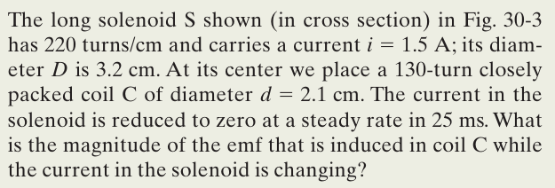
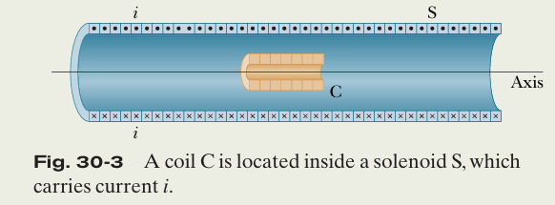
Sample Problem: Induced emf in coil due to a solenoid

Slide 33
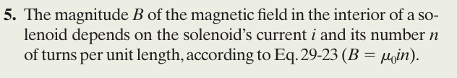
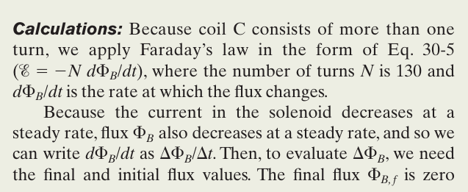
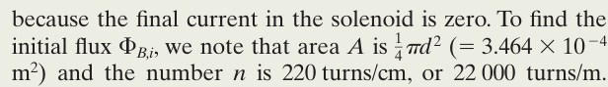
Hint (point 05)

Slide 34
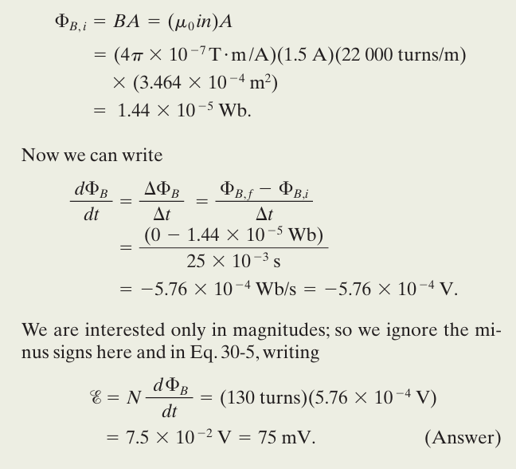

Slide 35
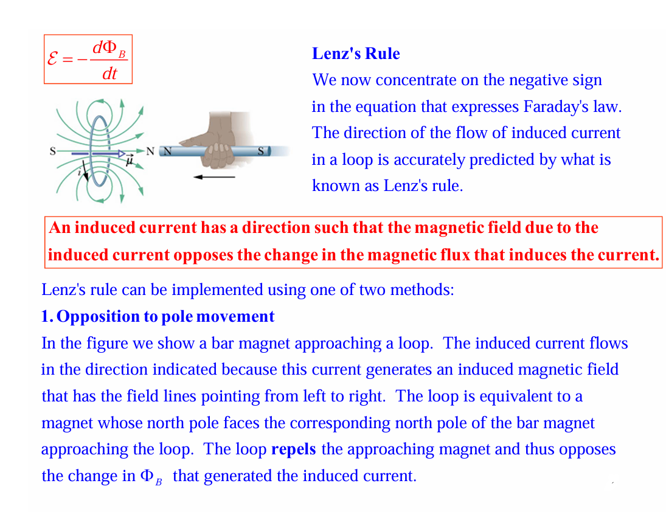

Slide 36
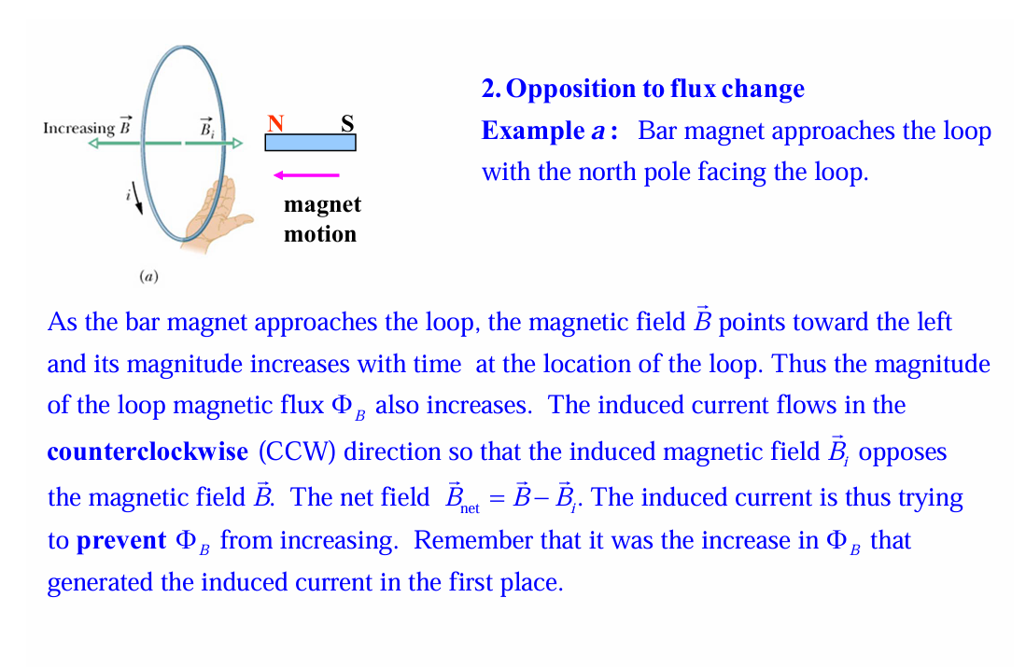

Slide 37
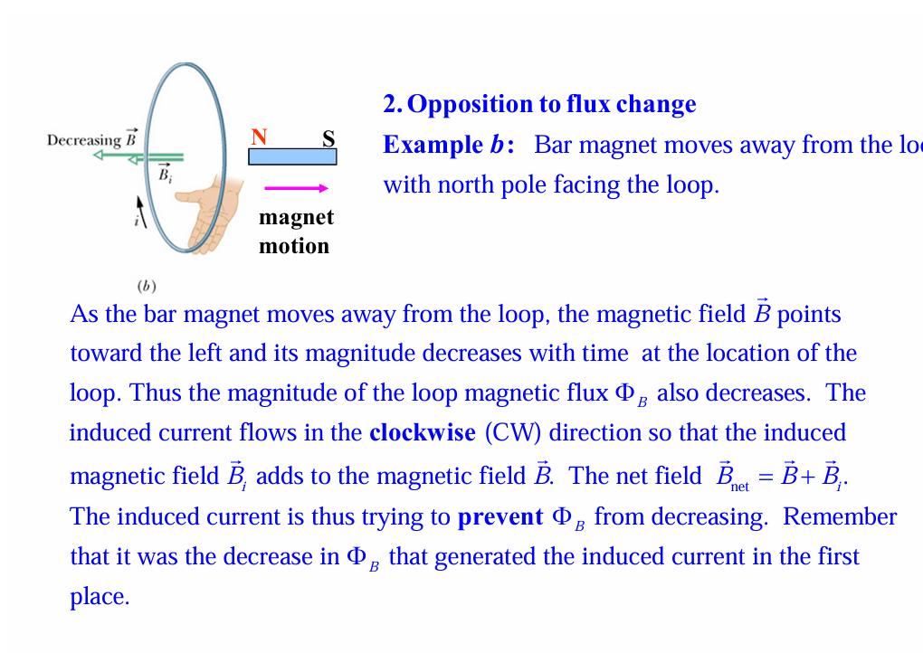

Slide 38
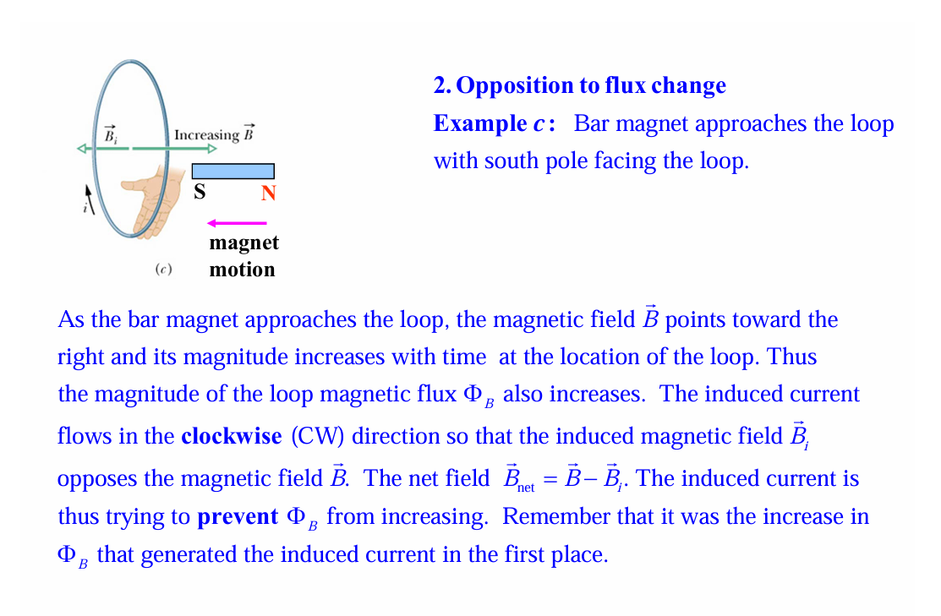

Slide 39
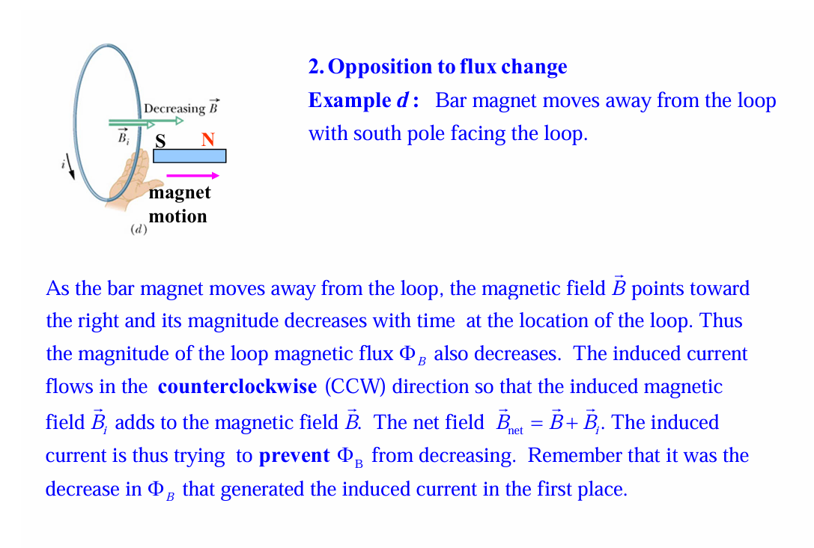

Slide 40
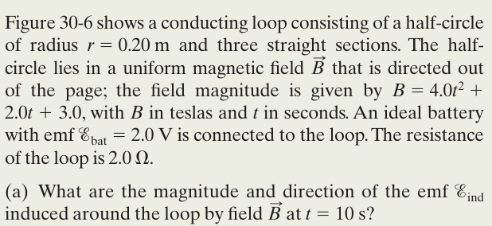
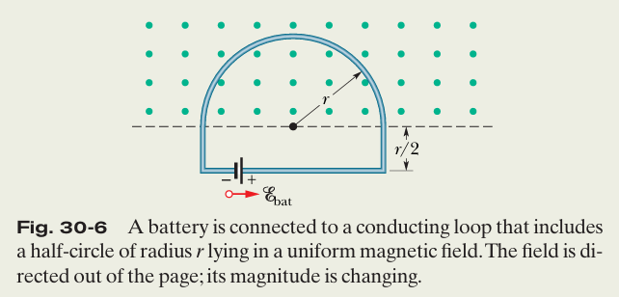
Sample Problem: Induced emf and current due to a changing uniform B field

Slide 41
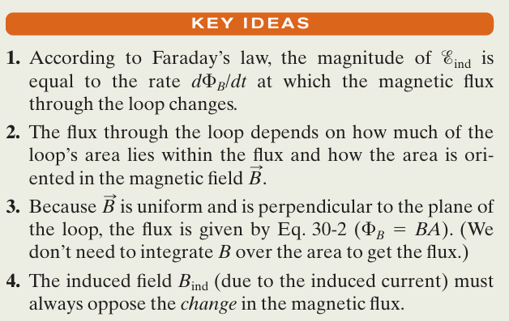
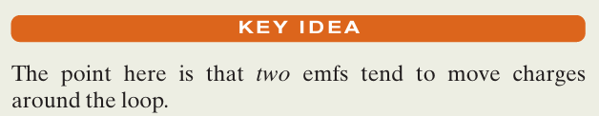
Important points for the sample problem
For the magnitude and Direction of EMF
For finding the current

Slide 42
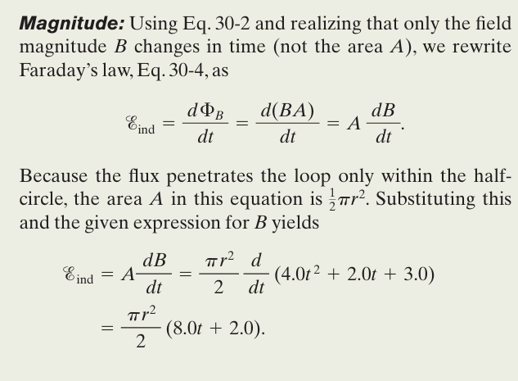
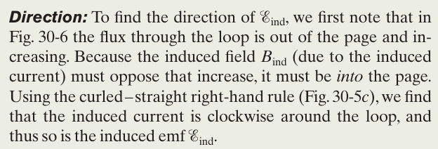
Solution for finding the EMF

Slide 43
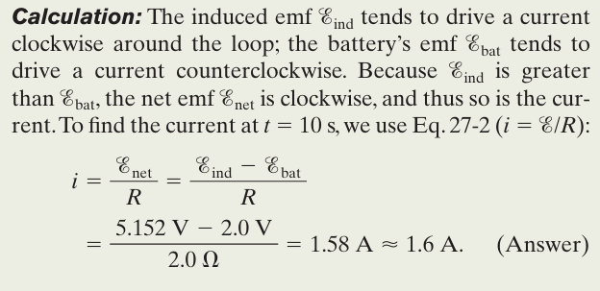
Solution for finding the current

Slide 44
The End

